Slide 1

E6893 Big Data Analytics:
Prediction of Stock Trend with Media Sentiment Analysis
201812-30
JILIANG MA (jm4750)
LONG JIAO (lj2463)
QINYUAN WEI (qw2264)

Slide 2
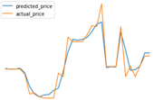

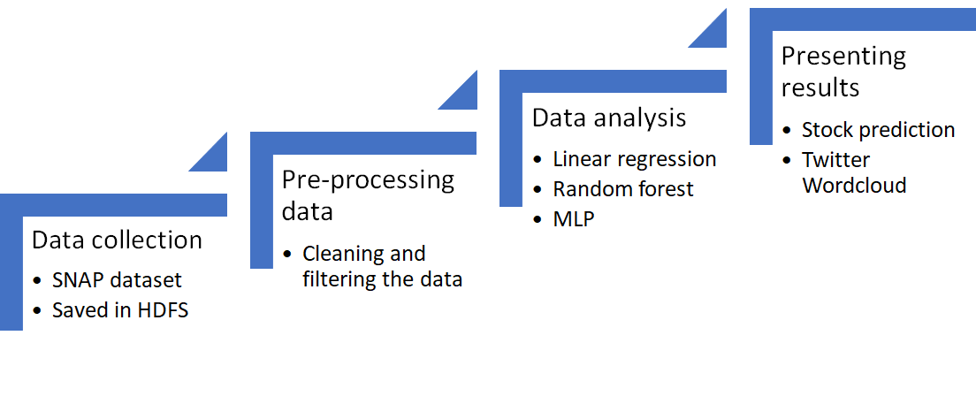


Overview
Notes:
Here is the overview of our project. Our project can be divided into 4 parts. First we do the data collection job with hadoop. We download our dataset from SNAP dataset and save it in HDFS. Then we use scala pre-processing the data. In the next part, we use python to do some data analysis job, such as linear regression, random forest and MLP. In the end, we use the technique we learned in class to present our results, such as stock prediction and twitter wordclouds.

Slide 3





Technologies Used
Tools
Hadoop
Spark
Jupyter Notebook
sklearn(MLP, Random Forest, Linear Regression)
D3
Node.js
Notes:
The tools we used include hadoop, spark, jupyter notebook, sklearn in python. And D3 and Node.js are used to present our results.

Slide 4
Dataset
Historical stock price dataset
Microsoft,Nasdaq
Yahoo Finance
Twitter7​ ​dataset​ ​​--from​ ​Stanford​ ​Large​ ​Network​ ​Data​ ​Collection(SNAP)
25GB​ ​
From​ ​June​ ​to​ ​December​ ​in​ ​2009
476​ ​million tweets​ ​collected
Includes​ ​17,069,982 users,​ ​476,553,560​ ​tweets,​ ​181,611,080​ ​URLs,​ ​49,293,684​ ​Hashtags​ ​and​ ​71,835,017 retweets.
Notes:
Here are the datasets we use. First we download the historical stock price of Microsoft and Nasdaq market from yahoo finance. And we use the Twitter7 dataset, which is from stanford large network data collection. It includes tweets from June to December in 2009 in a size of 25GB, with 476 million tweets collected, including huge amount of users, tweets and other related data.

Slide 5
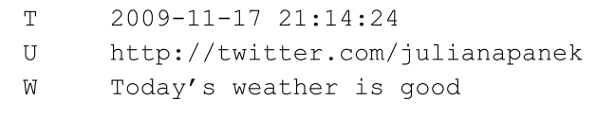
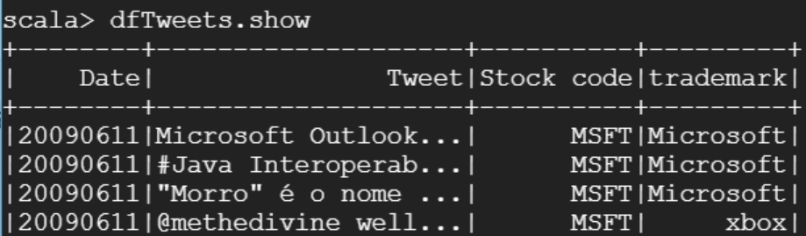
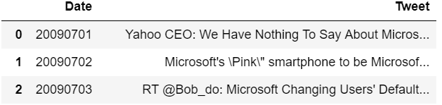
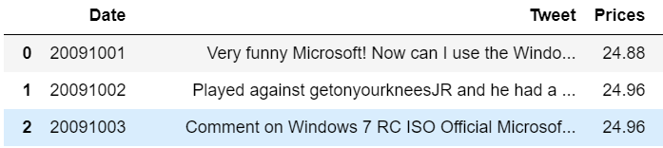
Algorithm
Data Pre-processing:
Read data: (scala)
load into HDFS
read in spark:
Data parsing & filtering: (scala)
only keep tweets and dates
filter all data by target trademarks
Combine data by date: (python)
Merge tweets with stock prices:
fill the blank data
Notes:
Here comes to our algorithm. We first do some data pre-processing job. We use scala to read the data into Spark from HDFS. Then we use scala to parse and filter the data. We only keep the tweets and dates in each tweet and filter all data by target trademarks, such as microsoft and xbox. Then we combine each data by date, which means cluster the tweets from the same day into one set. And then we merge the tweets with the stock prices. Since there are opening and closing days in stock market, we fill the blank data with the last day’s price which is not in a closing day.

Slide 6
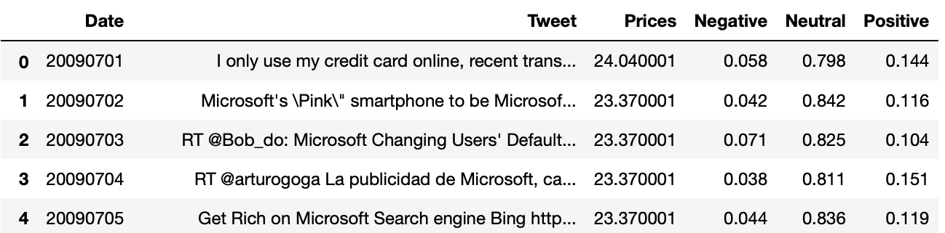
Algorithm
Data processing and analysis
Sentiment Analysis
We use vader_lexicon in NLTK to execute the sentiment analysis, get the polarity for the Tweets of each day, which is how much positive, negative, neutral the Tweets are.

Slide 7
Algorithm
Data processing and analysis
For data processing, the parameters in the machine learning include polarity of the Tweets, the close stock price of pre-day, the close Nasdaq Composite Index of pre-day.
We use Linear Regression, Random Forest and MLP in sklearn in Python to process the data, and compare the result of these three algorithm.

Slide 8
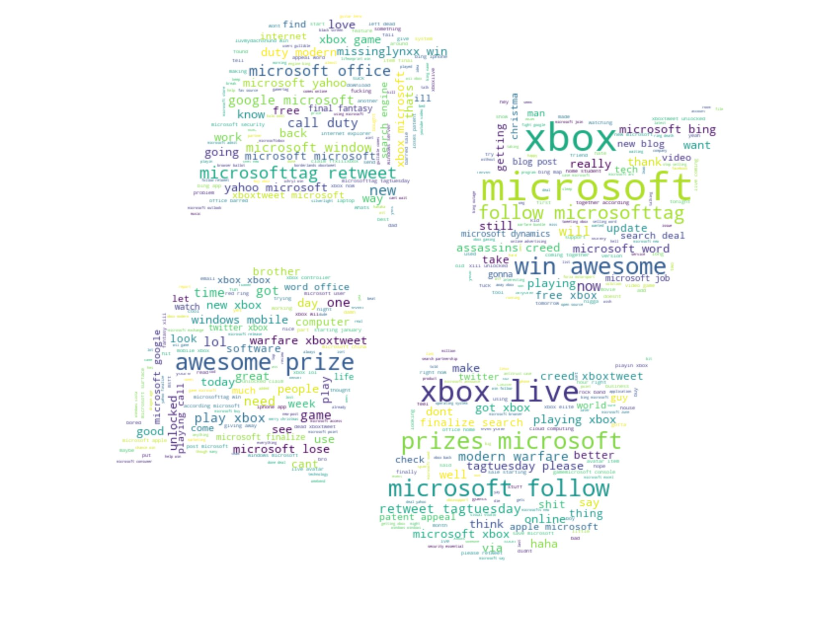
Results
Data visual
Draw word cloud of each month
Represent what people like to talk about Microsoft and its trademarks at that time
Word Cloud for December

Slide 9
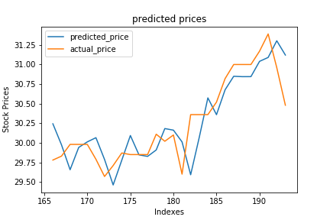
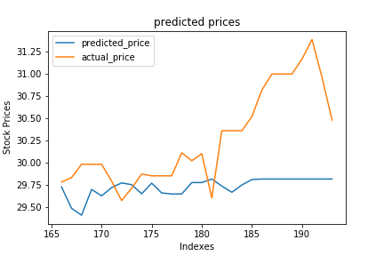
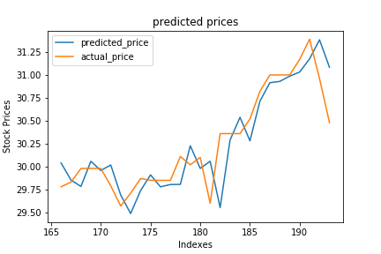
Results
Predict result (using 6-11th months as training set, 12th month as testing set)
Linear Regression Random Forest MLP

Slide 10
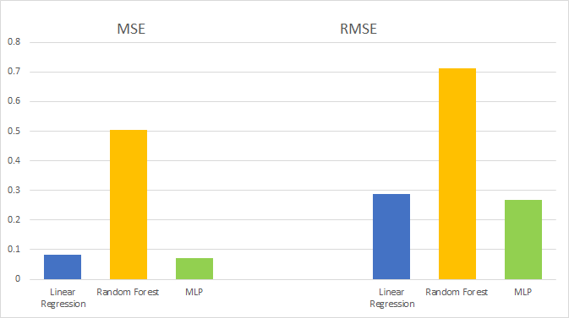
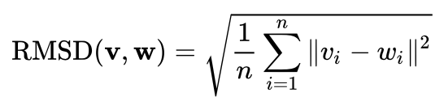
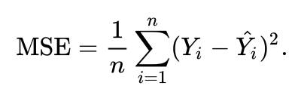
Results Evaluation
Root Mean Square Error:
Mean Square Error:

Slide 11
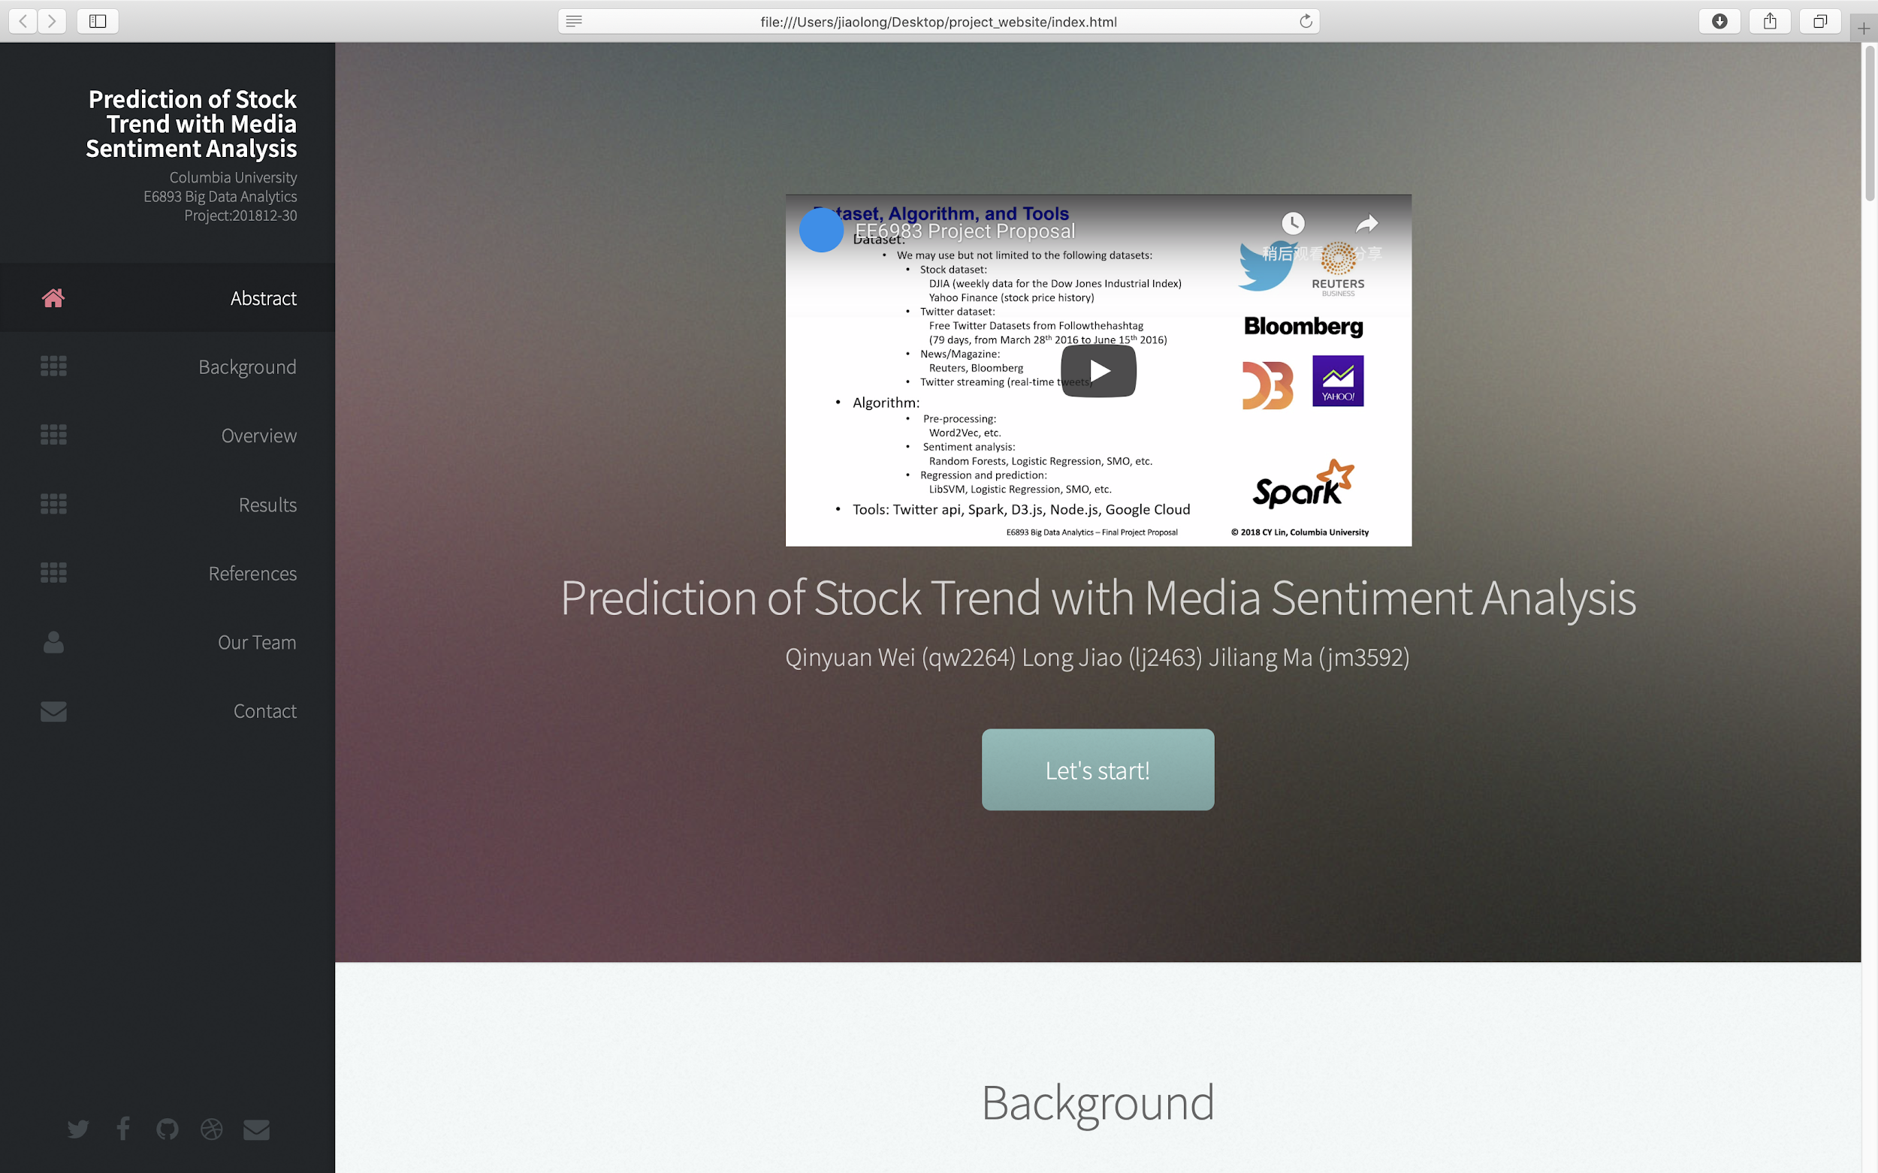
Website

Slide 12
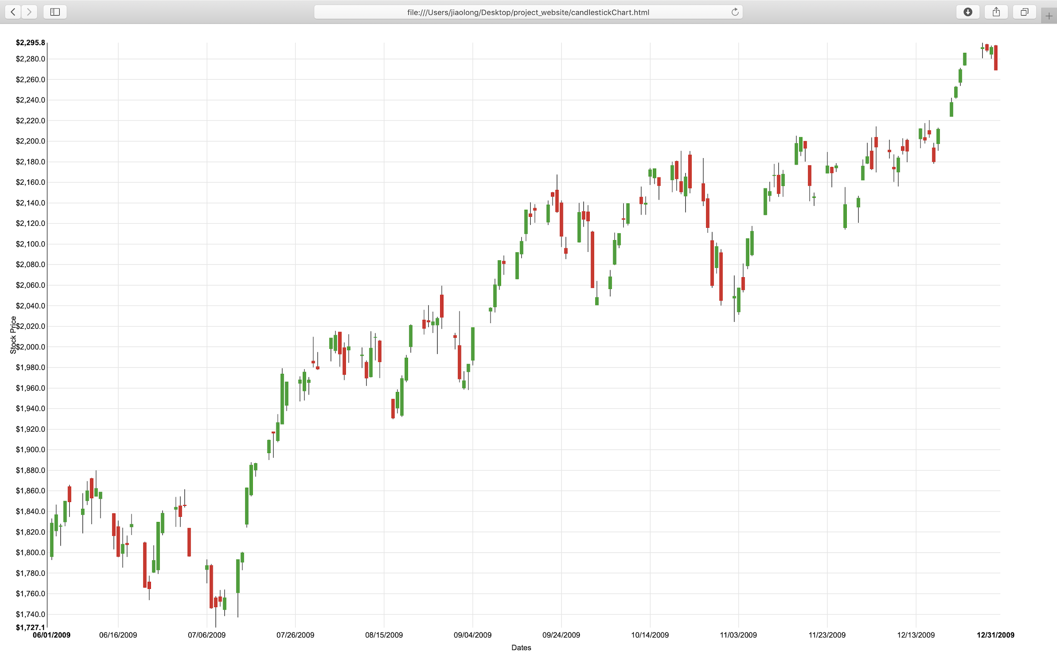
Website

Slide 13
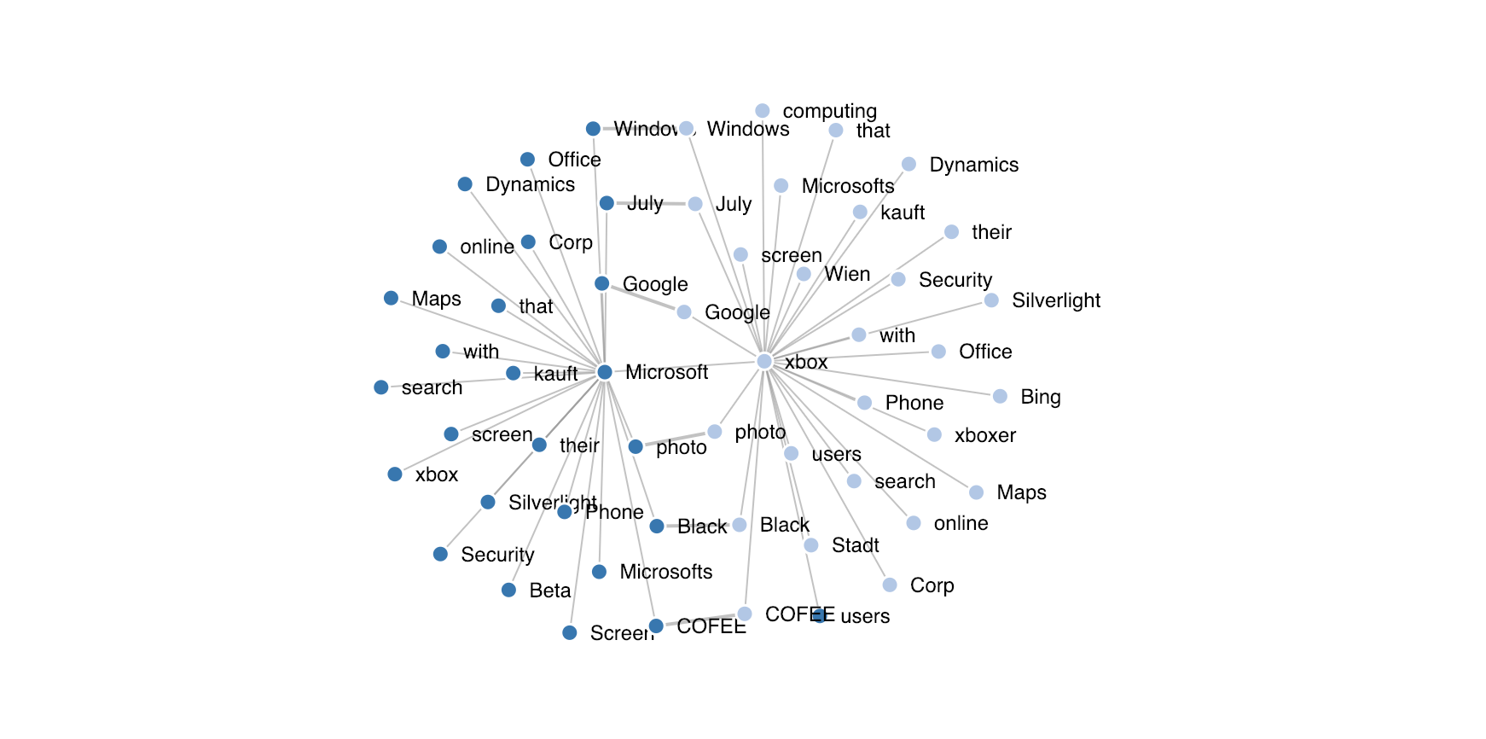
Website

Slide 14

Demo

Slide 15
Future work
Test on more companies/market prices
Use twitter api to gather more data and test (recent years data)
More indexes to prove the model is efficient

Slide 16
References
476 Million Twitter Tweets, J. Yang, J. Leskovec. Temporal Variation in Online Media . ACM International Conference on Web Search and Data Mining (WSDM '11), 2011. https://snap.stanford.edu/data/twitter7.html
Skuza, Micheal. Romanowski, Andrzej.(2015). Sentiment Analysis of Twitter Data within Big Data Distributed Environment for Stock Prediction DOI: 10.15439/2015F230 http://ieeexplore.ieee.org/stamp/stamp.jsp?arnumber=7321604&tag=1
Pagolu, S.Venkata. Reddy, N.Kamal. Panda, Ganapati (2016). Sentiment analysis of Twitter data for predicting stock market movements DOI: 10.1109/SCOPES.2016.7955659 http://ieeexplore.ieee.org/document/7955659/?part=1

Slide 17
Thanks!

